Slide 1

Automated Traffic Monitoring System
BY
Shinjinee Maiti(RA1911026010024)
Prakhar Alok Chaudhary (RA1911026010015)
Guide:
Dr. A. Revathi
Assistant Professor, Department of Computational Intelligence

Slide 2
CONTENTS
Abstract
Objectives
Problem Statement
Introduction
Literature Survey
Novelty
Workflow
ARCHITECTURE DIAGRAM
Annotation Process at Roboflow service
Model Structure
Final Model Output
Application
Conclusion
Future Work
Research Paper Status
References

Slide 3
ABSTRACT
This research paper focuses on the benefits, challenges, and applications of traffic monitoring systems, with a particular emphasis on the dynamic signal switching approach and the role of computer vision in traffic monitoring and management. The paper explores the potential of smart transport systems, which leverage advanced technologies such as GPS, sensors, computer vision, and big data analysis to collect real-time traffic data and make automatic decisions to optimize traffic flow. The dynamic signal-switching approach is highlighted as a critical component of smart transport systems, which adjusts traffic signal timing based on real-time traffic data to reduce congestion and improve traffic flow. Overall, this paper argues that traffic monitoring systems offer several benefits in terms of transportation efficiency, safety, and sustainability, and are increasingly necessary to address the challenges of traffic congestion and improve urban residents' quality of life.

Slide 4
OBJECTIVES
Develop an automated traffic management system that uses machine learning techniques to continuously sense the environment and adjust traffic signal timings in real-time.
Leverage computer vision technology to detect vehicles, pedestrians, and traffic signals in real-time traffic footage and use this information to dynamically adjust traffic signal timings.
Improve transportation operations and services by reducing traffic congestion, increasing traffic flow, and providing safer driving conditions.
Provide valuable insights into the benefits, challenges, and applications of traffic monitoring systems, with a particular emphasis on the dynamic signal switching approach and the role of computer vision in traffic monitoring and management.
Propose a system that can be adopted globally to address transportation challenges and promote sustainable urban development.
Demonstrate the potential of machine learning techniques in traffic management to revolutionize the way traffic is managed worldwide, leading to better traffic flow, reduced congestion, and increased safety for motorists.

Slide 5

PROBLEM STATEMENT
Current traffic management systems lack the ability to adapt to changing traffic conditions, resulting in delays, reduced traffic flow, and safety risks.
This research proposes developing an automated traffic management system that leverages machine learning and computer vision to improve transportation operations and services, reduce traffic congestion, and provide safer driving conditions for all road users.

Slide 6
INTRODUCTION
Traffic congestion and inefficient transportation operations are significant challenges faced by many cities worldwide, hindering economic development and negatively impacting the quality of life of urban residents.
The proposed research paper suggests developing an automated traffic management system that leverages machine learning techniques and computer vision technology to detect and respond to real-time traffic conditions.
The system aims to improve transportation operations and services, reduce traffic congestion, and provide safer driving conditions for all road users.
The proposed system will use supervised learning in traffic analysis and the pre-trained YOLO model for object detection in real-time traffic footage.
The obtained count will be used to assign the switching time for each side of the road dynamically.
The research aims to provide valuable insights into the benefits, challenges, and applications of traffic monitoring systems and demonstrate the potential of machine learning techniques in traffic management to revolutionize the way traffic is managed worldwide.

Slide 7
LITERATURE SURVEY
AUTHOR | YEAR | TITLE OF PAPER AND JOURNAL | AREA OF WORK | INFERENCE
Kaushik et al. | 2019 | "A survey on vehicle detection and tracking techniques" | Vehicle detection and tracking | Computer vision technologies significantly improve the performance and efficiency of traffic management systems.
Liu et al. | 2019 | "Real-time vehicle classification using deep convolutional neural networks" | Vehicle classification | Deep learning-based frameworks like CNNs are effective for vehicle classification.
Alomari et al. | 2016 | "Real-time traffic monitoring system using computer vision techniques" | Traffic flow estimation | Computer vision-based traffic monitoring systems can provide real-time traffic flow information for proactive traffic management.
El-halawany et al. | 2016 | "Smart parking system based on image processing and deep learning" | Congestion prediction | Smart parking systems can help predict congestion and optimize traffic flow.

Slide 8
NOVELTY
The proposed system uses machine learning algorithms for vehicle detection and counting in real-time traffic scenarios.
The YOLO machine learning model is used for object detection and vehicle counting, which is faster and more accurate than traditional object detection methods.
The system utilizes CCTV cameras to capture real-time traffic data, enabling efficient and coordinated use of traffic networks.
The pre-written Python program dynamically adjusts the traffic signal switching based on the number of vehicles present in each lane, ensuring 24/7 traffic safety and hassle-free traffic management without the need for human intervention.
The proposed system is designed to adapt to changing traffic scenarios, resulting in improved traffic efficiency and congestion reduction compared to the traditional static signal switching system.

Slide 9
WORKFLOW
Camera setup: Install cameras at the busy crossing to capture live video footage of the traffic and pedestrian movements in each lane.
Video processing pipeline: Use a video processing pipeline to process the live camera feed and extract relevant frames for object detection.
Object detection: Apply the YOLOv3 model to the extracted frames to detect and count vehicles and pedestrians in each lane.
Signal duration calculation: Feed the object counts obtained from the YOLOv3 model into the dynamic_traffic_signal_switching function to calculate the signal durations for vehicles and pedestrians.
Traffic signal control: Send the calculated signal durations to the traffic signal controller to adjust the green light durations for each lane and the pedestrian crossing.
Loop: Continuously repeat steps 2-5 in a loop, updating the signal durations at regular intervals or when significant changes in traffic and pedestrian volumes are detected.

Slide 10
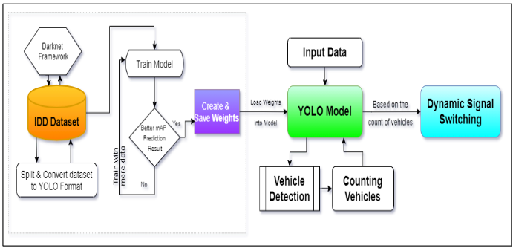
ARCHITECTURE DIAGRAM
ITMS – Architecture Diagram

Slide 11
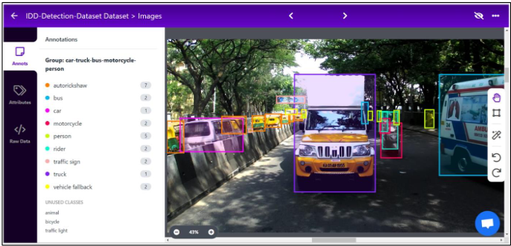
Annotation Process at Roboflow service
Example of Annotation Process at Roboflow service

Slide 12
MODEL STRUCTURE
Data Capture: Real-time traffic data is captured through CCTV cameras already installed in highways or traffic signals.
Data Processing: The captured data is processed and fed into a machine learning model called You Only Look Once (YOLO).
Object Detection: The YOLO model performs object detection on the processed data, accurately detecting and counting vehicles in each lane.
Python Program: A pre-written Python program is utilized to automate the traffic signal switching process based on the vehicle count data obtained from the YOLO model.
Dynamic Signal Switching: The Python program dynamically adjusts the traffic signal switching based on the number of vehicles present in each lane, enabling more efficient and coordinated use of traffic networks.
Continuous Learning: The machine learning model is trained continuously to adapt to different scenarios, reducing the occurrence of scenarios that could lead to model failure.
Customization: The model can be customized with additional functions such as closing the signal for pedestrians crossing, prioritizing the lane for ambulance, and monitoring vehicles.

Slide 13
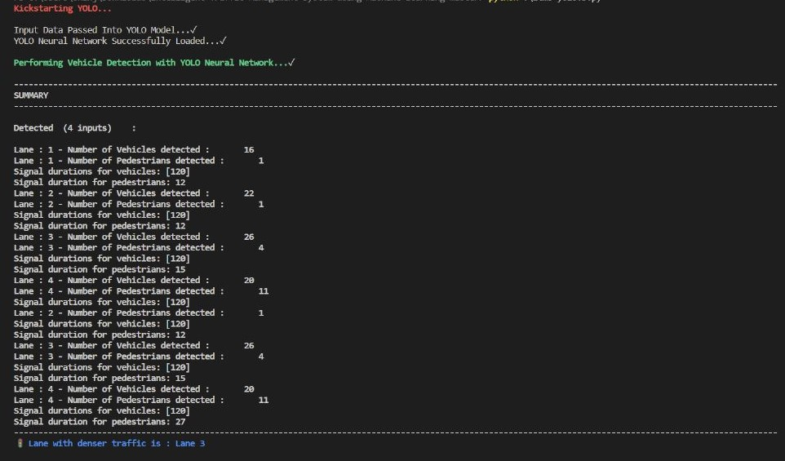
FINAL MODEL OUTPUT

Slide 14
APPLICATION
The proposed traffic management system can be implemented in busy intersections and highways to improve traffic flow, reduce congestion, and enhance road safety.
The system can be deployed in smart cities and transportation networks to provide real-time traffic data and automated traffic signal switching based on vehicle count.
The system can be customized to cater to different traffic scenarios and to prioritize emergency vehicles, pedestrians, and cyclists for safer and more efficient transportation.

Slide 15

CONCLUSION
Our proposed model uses machine learning to detect and count vehicles, improving traffic flow and management.
Future work can include implementing a backup plan for adverse weather conditions and adding cloud computation support to enhance data logging.
Continuous training and customization of the model with additional functions can further improve its efficiency and effectiveness in traffic management.

Slide 16
FUTURE WORK
Implement a timer-approach as a backup plan in case the model fails to detect vehicles during crucial times such as bad weather or low visibility.
Add cloud computation support to log traffic data for each lane with date and time to further improve traffic flow.
Train the machine learning model continuously to adapt to different scenarios, which can significantly reduce the occurrence of scenarios that could lead to model failure.
Customize the model with additional functions such as closing the signal for pedestrians crossing, prioritizing the lane for ambulance, and monitoring vehicles.

Slide 17
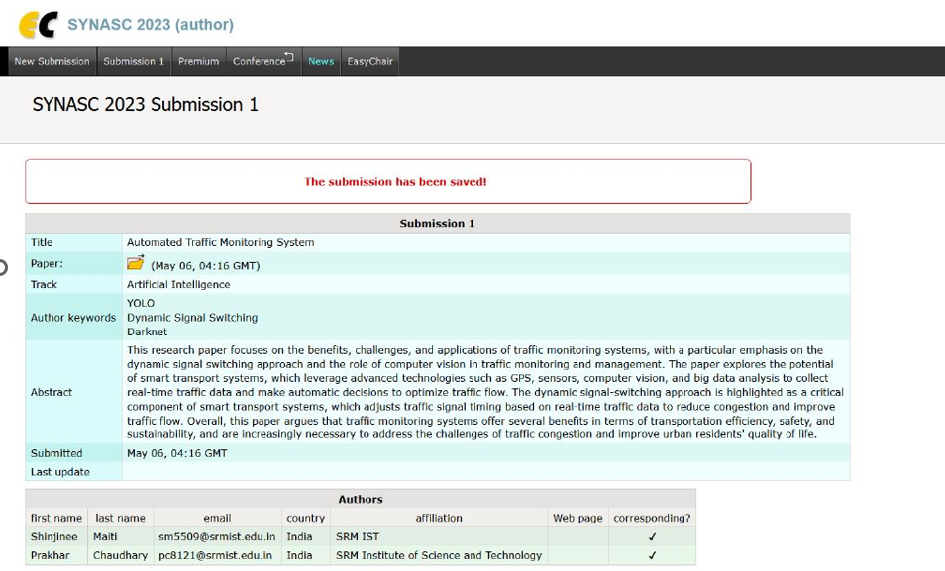
RESEARCH PAPER STATUS
We submitted our paper in SYNASC 2023 and we are waiting for the acceptance.

Slide 18
REFERENCES
[1] Adaptive background mixture models for real-time tracking Stauffer, C., & Grimson, W.E.L. (1999). Proceedings of the IEEE Computer Society Conference on Computer Vision and Pattern Recognition.
[2] An iterative image registration technique with an application to stereo vision Lucas, B.D., & Kanade, T. (1981). Proceedings of the 7th International Joint Conference on Artificial Intelligence.
[3] . You only look once: Unified, real-time object detection Redmon, J., Divvala, S., Girshick, R., & Farhadi, A. (2016). Proceedings of the IEEE Conference on Computer Vision and Pattern Recognition
[4] Vehicle classification using PCA and SVM for traffic surveillance systems Zheng, T., Wang, S., & Lu, Y. (2006). Proceedings of the IEEE International Conference on Intelligent Transportation Systems.
[5] ImageNet classification with deep convolutional neural networks Krizhevsky, A., Sutskever, I., & Hinton, G.E. (2012). Advances in Neural Information Processing Systems.
[6] Real-time freeway traffic state estimation based on extended Kalman filter: A general approach Wang, Y., & Papageorg
[7] "Real-Time Traffic Monitoring Using Computer Vision" by Zaklouta et al. (2009)
[8] "Traffic Flow Analysis Using Computer Vision Techniques" by Zou et al. (2011)
[9] "Smart Parking System Based on Image Processing and Artificial Intelligence" by Al-Fahaam et al. (2011)
[10] "Real-Time Object Detection and Tracking for Intelligent Transportation Systems" by Chen et al. (2013)

Slide 19
REFERENCES
[11] "Real-Time Traffic Flow Analysis Using Deep Learning Techniques" by Nguyen et al. (2018)
[12] Indrabayu, R. Y. Bakti, I. S. Areni and A. A. Prayogi, "Vehicle detection
and tracking using Gaussian Mixture Model and Kalman Filter," 2016
International Conference on Computational Intelligence and Cybernetics,
Makassar,2016,pp.115-119,doi: 10.1109/CyberneticsCom.2016.7892577.
[13] S. Maqbool, M. Khan, J. Tahir, A. Jalil, A. Ali and J. Ahmad, "Vehicle
Detection, Tracking and Counting", 2018 IEEE 3rd International Conference on
Signal and Image Processing (ICSIP), Shenzhen, 2018, pp. 126-132, doi:
10.1109/SIPROCESS.2018.8600460.
[14] R. Krishnamoorthy and S. Manickam, "Automated Traffic Monitoring
Using Image Vision", 2018 Second International Conference on Inventive
Communication and Computational Technologies (ICICCT), Coimbatore, 2018,
pp. 741-745, doi: 10.1109/ICICCT.2018.8473086.
[15] J. T. G. Nodado, H. C. P. Morales, M. A. P. Abugan, J. L. Olisea, A. C.
Aralar and P. J. M. Loresco, "Intelligent Traffic Light System Using Computer
Vision with Android Monitoring and Control", TENCON 2018 - 2018 IEEE
Region 10 Conference, Jeju, Korea (South), 2018, pp. 2461-2466, doi:
10.1109/TENCON.2018.8650084

Slide 20
THANK YOU

